Slide 1




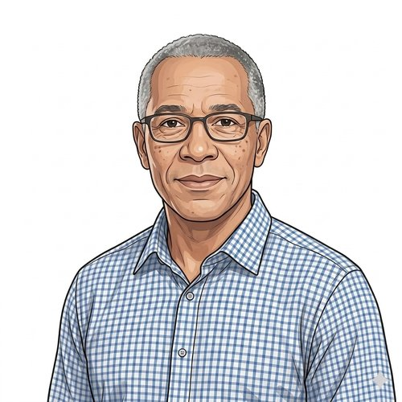
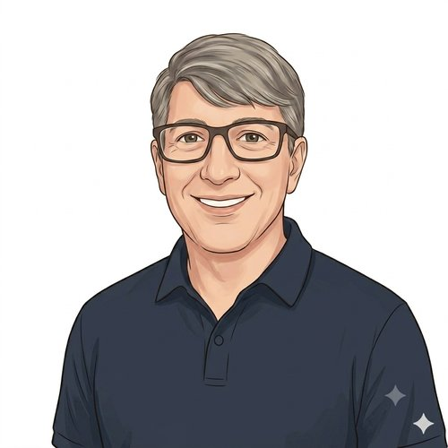
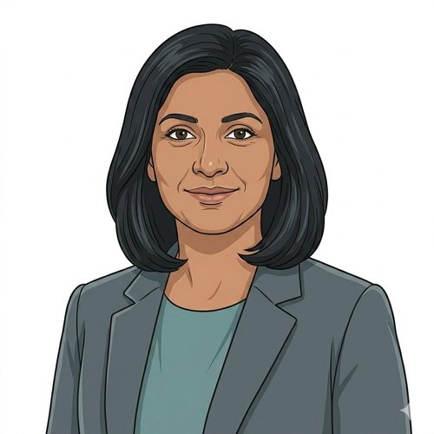
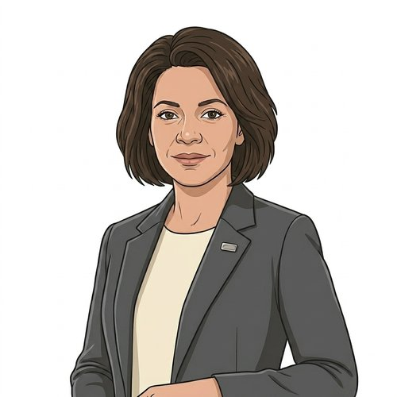
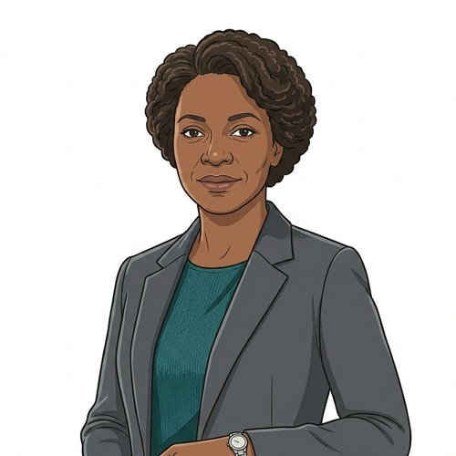
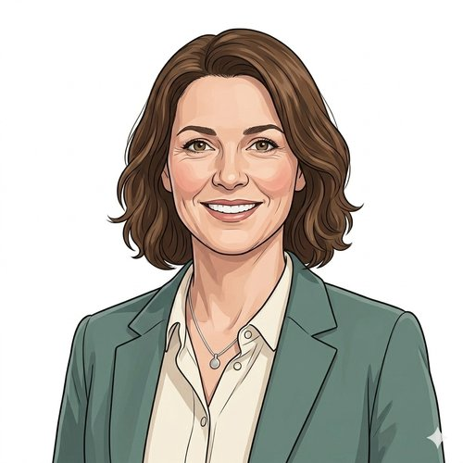
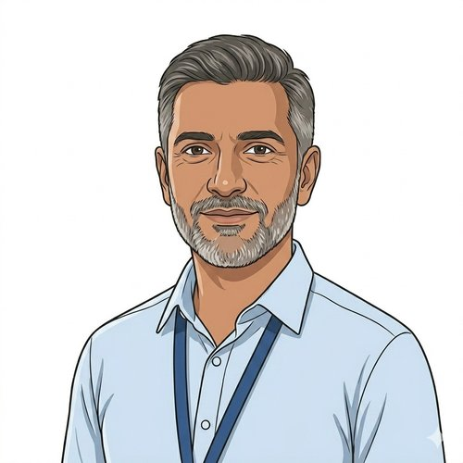
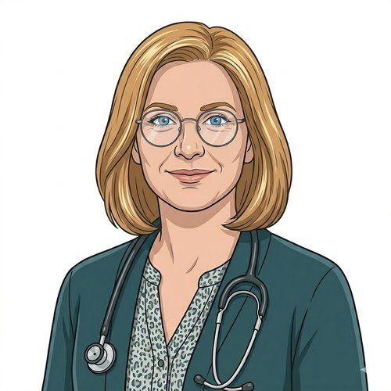
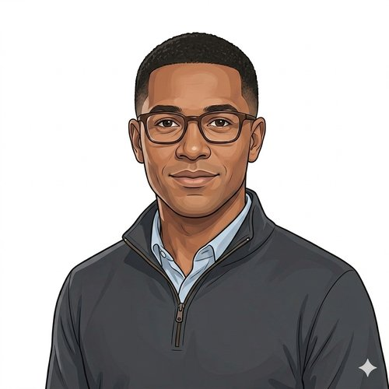
HEARTS AND MINDS · THE WHOLE CAST
Twelve people. One operating model.
Abdul
Devi
Layla
Mark
Patient
Patient
Patient
Patient
Every service in the model is designed around named people: the patients it must reach, the commissioners who buy it, the clinicians who order it and read the results, and the suppliers who make it work. This deck is one slide per person, each drawn from their full journey.
Sean
Anita
Catherine
Ruth
Patient
Commissioner
Commissioner
Commissioner
Sarah
Adam
Hannah
Joe
Commissioner
Clinician
Clinician
Supplier
Hearts and Minds · the whole cast, one deck · HomeTest operating model · September 2026
Commercial positions are agreed in principle and remain subject to the live procurement.

Slide 2
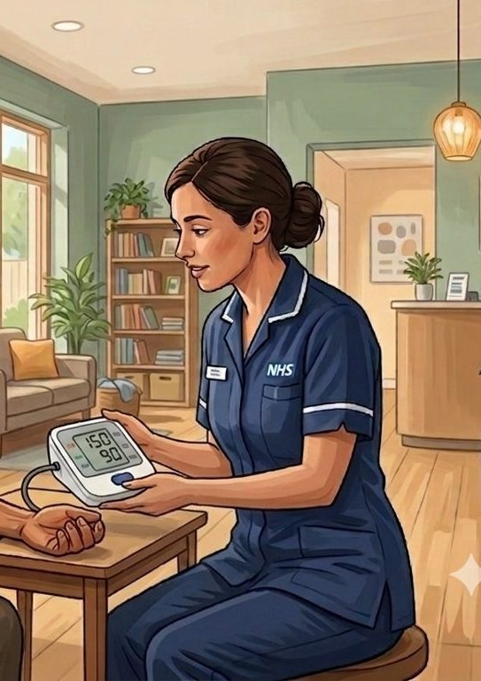
PATIENT · A PATIENT'S STORY THROUGH THE OPERATING MODEL
Abdul
Self-initiated patient · CVKM cohort
Hidden risk, found by his app.
Abdul is 38, works full-time, has young kids, and knows heart trouble runs in his family. The NHS App nudges him toward a home test that catches cardiovascular risk markers nobody else was going to find. This is the story of how the cohort gets identified before the symptoms show up.
1
2
3
4
5
Stratification
Identification
Diagnosis
Treatment
Long-term optimisation
The system finds him before the symptoms find him. Abdul does not feel ill. He has never been to the GP about his heart. The cohort he belongs to, middle-aged men with family-history risk, is exactly the cohort the in-clinic system finds last. The home pathway finds him first.
Hearts and Minds · the whole cast, one deck · HomeTest operating model · September 2026
Commercial positions are agreed in principle and remain subject to the live procurement.
2
Notes:
Abdul: Hidden risk, found by his app. Abdul is 38, works full-time, has young kids, and knows heart trouble runs in his family. The NHS App nudges him toward a home test that catches cardiovascular risk markers nobody else was going to find. This is the story of how the cohort gets identified before the symptoms show up.

Slide 3

PATIENT · A PATIENT'S STORY THROUGH THE OPERATING MODEL
Devi
At-risk register · HbA1c annual review · Primary-care surveillance cohort
A Saturday, not a sick day.
Devi is 47, works full-time as a care coordinator, has two children and a mother she helps care for. Her GP, Hannah, holds her on the practice at-risk register. Family history of type 2 diabetes and her ethnicity put her HbA1c on annual review. Her last result sat at 44 mmol/mol, comfortably below diagnosis but firmly in the pre-diabetes band. The Tuesday-morning slot to get the next blood was never going to happen. This is the story of how she stays in surveillance without staying out of work.
1
2
3
4
5
Stratification
Identification
Testing
Response
Long-term optimisation
The bloods need doing. The clinic visit never needed to be the way to do them. Devi is on the at-risk register. The register needs an annual HbA1c or the cohort drifts. The clinic has always been the venue for the annual bloods, but the clinic is exactly the venue that does not work for her life. Move the venue. Keep the surveillance.
Hearts and Minds · the whole cast, one deck · HomeTest operating model · September 2026
Commercial positions are agreed in principle and remain subject to the live procurement.
3
Notes:
Devi: A Saturday, not a sick day. Devi is 47, works full-time as a care coordinator, has two children and a mother she helps care for. Her GP, Hannah, holds her on the practice at-risk register. Family history of type 2 diabetes and her ethnicity put her HbA1c on annual review. Her last result sat at 44 mmol/mol, comfortably below diagnosis but firmly in the pre-diabetes band. The Tuesday-morning slot to get the next blood was never going to happen. This is the story of how she stays in surveillance without staying out of work.

Slide 4

PATIENT · A PATIENT'S STORY THROUGH THE OPERATING MODEL, GP-INITIATED, TOLD AS AN ILLUSTRATION
Layla
GP-initiated patient · Iron deficiency anaemia · held configuration
Three years on the tablets. The trend is the treatment.
Layla is 42, a single parent with two school-age kids and two part-time jobs, one of them on shifts. Her iron deficiency anaemia was diagnosed three years ago; she has been on ferrous sulphate since, and her GP, Hannah, needs a full blood count and ferritin every six months to know whether it is still working. Nobody doubts Layla will take the tablets. The question is whether anyone will see the trend. This is the story of a monitoring cycle that holds because it stopped asking for her working hours. It is told as an illustration: the anaemia configuration is held under the Prioritisation Framework, not in build.
1
2
3
4
5
Stratification
Identification
Diagnosis
Treatment
Long-term optimisation
Known, treated, and never quietly lost. Layla is not a diagnosis waiting to happen. She is a patient the system already knows and already treats. The failure mode for someone like her is not a missed screen but a missed check: a six-month cycle that slips to nine, then twelve, while the iron dose that was right three years ago quietly stops being right. Hold the cycle and you hold the treatment.
Hearts and Minds · the whole cast, one deck · HomeTest operating model · September 2026
Commercial positions are agreed in principle and remain subject to the live procurement.
4
Notes:
Layla: Three years on the tablets. The trend is the treatment. Layla is 42, a single parent with two school-age kids and two part-time jobs, one of them on shifts. Her iron deficiency anaemia was diagnosed three years ago; she has been on ferrous sulphate since, and her GP, Hannah, needs a full blood count and ferritin every six months to know whether it is still working. Nobody doubts Layla will take the tablets. The question is whether anyone will see the trend. This is the story of a monitoring cycle that holds because it stopped asking for her working hours. It is told as an illustration: the anaemia configuration is held under the Prioritisation Framework, not in build.

Slide 5

PATIENT · A PATIENT'S STORY THROUGH THE OPERATING MODEL
Mark
Patient on active surveillance · PSA-AS cohort
His consultant still reads the trend.
Mark is 65. Diagnosed with low-risk prostate cancer and placed on active surveillance under Adam at the local trust. The quarterly PSA is supposed to be routine. The clinic trip to get it is anything but. This is the story of how the surveillance happens at home and the clinical accountability stays in clinic.
1
2
3
4
5
Stratification
Identification
Diagnosis
Treatment
Long-term optimisation
His consultant still holds the cohort. The quarterly visit just does not need to be in clinic. Mark trusts Adam. The active-surveillance cohort works because the clinician is reading the trend. The home pathway preserves the clinical role and removes the clinic visit that did nothing but draw the blood.
Hearts and Minds · the whole cast, one deck · HomeTest operating model · September 2026
Commercial positions are agreed in principle and remain subject to the live procurement.
5
Notes:
Mark: His consultant still reads the trend. Mark is 65. Diagnosed with low-risk prostate cancer and placed on active surveillance under Adam at the local trust. The quarterly PSA is supposed to be routine. The clinic trip to get it is anything but. This is the story of how the surveillance happens at home and the clinical accountability stays in clinic.

Slide 6

PATIENT · A PATIENT'S STORY THROUGH THE OPERATING MODEL
Sean
Horizontal cohort patient · The access story
Reaching him.
Sean has been on every NHS list since he was a child. Being on the lists has never been the hard part. The path from being identified, to getting the test done on time, to the result reaching the family who can act on it. That is where it falls down. The clinic venue assumes a prepared adult arriving on time. Sean is not that adult, for reasons that are neither his fault nor solvable by a flag on his record. This is the story of what changes when the test comes to him.
1
2
3
4
5
Stratification: the cohort the system identifies but doesn't reach
Identification: the offer that reaches the people who can act on it
Diagnosis: a test on his terms
Treatment: the result lands with the people who can act on it
Long-term optimisation: the cohort the system actually holds
Identification has never been the problem. The chain after it is. Sean's cohort lives 19.5 years shorter than the rest of the population. Thirty-nine per cent of those deaths are judged avoidable. The flags, the registers and the legal duty to provide accessible information have all been in place for years. The home pathway is the first venue where the system finally reaches the person it has been carrying on a list.
Hearts and Minds · the whole cast, one deck · HomeTest operating model · September 2026
Commercial positions are agreed in principle and remain subject to the live procurement.
6
Notes:
Sean: Reaching him. Sean has been on every NHS list since he was a child. Being on the lists has never been the hard part. The path from being identified, to getting the test done on time, to the result reaching the family who can act on it. That is where it falls down. The clinic venue assumes a prepared adult arriving on time. Sean is not that adult, for reasons that are neither his fault nor solvable by a flag on his record. This is the story of what changes when the test comes to him.

Slide 7
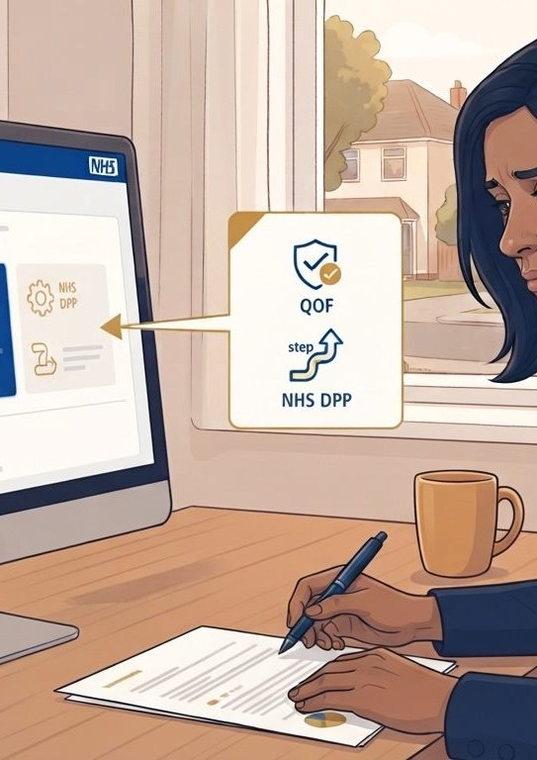
COMMISSIONER · AN ICB/GP COMMISSIONER'S STORY THROUGH THE OPERATING MODEL
Anita
ICB / GP commissioner · HomeTest HbA1c
Anita commissions the register. Not each appointment.
Anita commissions primary-care diagnostic monitoring for her Integrated Care Board. HbA1c annual reviews for the at-risk register run into tens of thousands annually across her patch. The register is growing as diabetes-prevention referrals build the risk cohort. Practice nurses are scarce. Phlebotomy appointments are the bottleneck. The cohort most likely to miss the appointment is the cohort most in need of the surveillance, shift workers, carers, deprived-ward residents. She has the QOF-adjacent funding architecture, no landed home-testing route, and a growing register. This is the story of one ICB/GP commissioner, one platform, one register-level arrangement, and an operating model that lets her commission at register scale rather than practice by practice.
1
2
3
4
5
6
The brief · a register
One front door · the framework opens
Fit for the at-risk register · the questions the register has to answer
One call-off · commissioning the register
Live operation · kits out
The ICB paper · what the CMO sees
Commission at register scale. So the annual HbA1c review cadence holds across the at-risk cohort without pulling clinic slots. ICB/GP commissioners do not want a separate deal per GP practice. They want one register-level arrangement that every at-risk patient across their ICB flows through, regardless of which practice they attend. The operating model exists so the ICB commissions the annual HbA1c review at register level and each practice plugs in against a common national arrangement. Register-level commissioning is the North Star, because effort spent stitching practice-by-practice deals is effort not spent holding the cadence.
Hearts and Minds · the whole cast, one deck · HomeTest operating model · September 2026
Commercial positions are agreed in principle and remain subject to the live procurement.
7
Notes:
Anita: Anita commissions the register. Not each appointment. Anita commissions primary-care diagnostic monitoring for her Integrated Care Board. HbA1c annual reviews for the at-risk register run into tens of thousands annually across her patch. The register is growing as diabetes-prevention referrals build the risk cohort. Practice nurses are scarce. Phlebotomy appointments are the bottleneck. The cohort most likely to miss the appointment is the cohort most in need of the surveillance, shift workers, carers, deprived-ward residents. She has the QOF-adjacent funding architecture, no landed home-testing route, and a growing register. This is the story of one ICB/GP commissioner, one platform, one register-level arrangement, and an operating model that lets her commission at register scale rather than practice by practice.

Slide 8
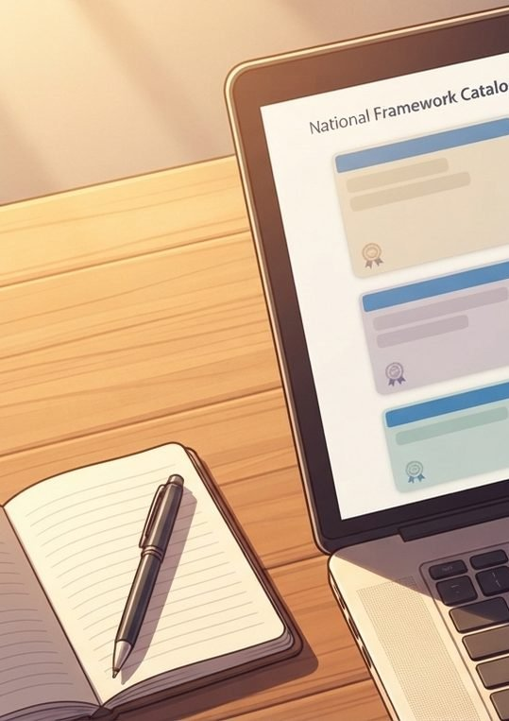
COMMISSIONER · AN ICB COMMISSIONER'S STORY THROUGH THE OPERATING MODEL
Catherine
ICB commissioner · HomeTest PSA active surveillance
Catherine commissions the pathway. Not each patient.
Catherine commissions the PSA active-surveillance pathway across her Integrated Care Board. Consultant urologists across her acute Trusts follow the NICE NG131 monitoring cadence for men on AS; the patient volume runs into hundreds annually across her ICB. Today the pathway sits on outpatient tariff and phlebotomy access, both of which are pinching against post-pandemic clinic capacity. She has the budget envelope, an NHS-mandate route into her Trust partners, and no existing framework to lean on for home-collected sampling at scale. This is the story of one ICB commissioner, one platform, one national arrangement, and an operating model that lets her commission the pathway rather than each patient.
1
2
3
4
5
6
The brief · an AS caseload
One front door · the framework opens
Fit for the AS cohort · the questions the pathway has to answer
The NHS mandate · commissioning the pathway
Live operation · kits out
The ICB paper · what the CMO sees
Commission the pathway, not the patient. So the ICB buys once and the AS caseload holds together across Trusts. ICB commissioners do not want a separate contract per Trust. They want one pathway-level arrangement that every AS patient in their system can flow through, regardless of which Trust is doing their monitoring. The operating model exists so the ICB commissions the AS pathway once at pathway level and each Trust plugs in against a common national arrangement. Pathway-level commissioning is the North Star, because effort spent stitching Trust-by-Trust deals is effort not spent on the caseload.
Hearts and Minds · the whole cast, one deck · HomeTest operating model · September 2026
Commercial positions are agreed in principle and remain subject to the live procurement.
8
Notes:
Catherine: Catherine commissions the pathway. Not each patient. Catherine commissions the PSA active-surveillance pathway across her Integrated Care Board. Consultant urologists across her acute Trusts follow the NICE NG131 monitoring cadence for men on AS; the patient volume runs into hundreds annually across her ICB. Today the pathway sits on outpatient tariff and phlebotomy access, both of which are pinching against post-pandemic clinic capacity. She has the budget envelope, an NHS-mandate route into her Trust partners, and no existing framework to lean on for home-collected sampling at scale. This is the story of one ICB commissioner, one platform, one national arrangement, and an operating model that lets her commission the pathway rather than each patient.

Slide 9
COMMISSIONER · A MONITORING-GAP COMMISSIONER'S STORY THROUGH HOMETEST, HELD OPEN AS A WORKING HYPOTHESIS
Ruth
Monitoring-gap commissioner · HomeTest PSA active surveillance · TBC
The cohort between two budgets, and the commissioner who has to own it.
Ruth is the commissioner who will buy PSA monitoring for men referred to Urology with a raised PSA and no cancer diagnosis. Today that cohort sits between primary and secondary care, with no single budget holder, no agreed protocol cadence and no one counting whether the monitoring happens. This is the journey the model expects her to take once the cohort design lands, told in six stages, with the open specifics deliberately left open.
1
2
3
4
5
6
The brief · a cohort between two budgets
One front door · what the framework has already settled
Fit for this cohort · the protocol has to exist first
The buy · a call-off once the owner is clear
Live operation · the gap closes
The case for funding · early detection
Close a monitoring gap that nobody currently owns Men referred to Urology with a raised PSA and no cancer found go back to their GP with an instruction to keep an eye on it. Some are monitored well. Some drift. The cohort has no single budget holder, no agreed cadence and no one measuring whether the monitoring happens. Ruth's job is to make that cohort someone's responsibility, with a supplier behind it that has already been assured.
Hearts and Minds · the whole cast, one deck · HomeTest operating model · September 2026
Commercial positions are agreed in principle and remain subject to the live procurement.
9
Notes:
Ruth: The cohort between two budgets, and the commissioner who has to own it. Ruth is the commissioner who will buy PSA monitoring for men referred to Urology with a raised PSA and no cancer diagnosis. Today that cohort sits between primary and secondary care, with no single budget holder, no agreed protocol cadence and no one counting whether the monitoring happens. This is the journey the model expects her to take once the cohort design lands, told in six stages, with the open specifics deliberately left open.

Slide 10

COMMISSIONER · A COMMISSIONER'S STORY THROUGH THE OPERATING MODEL
Sarah
LA sexual health commissioner · HomeTest HIV
Sarah signs once. Not once a quarter.
Sarah commissions sexual health for her Local Authority. UKHSA data shows an HIV detection gap concentrated in the wards her service struggles hardest to reach. She has the budget. She does not have the headcount to design a bespoke procurement around home self-testing for every supplier on the market. This is the story of one commissioner, one platform, one signature, and an operating model that does the procurement work for her.
1
2
3
4
5
6
The brief · a population
One front door · the framework opens
Fit for HER cohort · the questions standard answers don't solve
One call-off · signing
Live operation · kits out
The board paper · what the members see
Easy buying. So the buying gets out of the way and the population outcome stays in focus. Commissioners do not buy home testing for the joy of running procurements. They buy it to close a detection gap, reduce late diagnoses, or get more out of a stretched service. The operating model exists so the buying stops being the work. Easy buying is the North Star, not because procurement should be lazy, but because effort spent on procurement is effort not spent on population health.
Hearts and Minds · the whole cast, one deck · HomeTest operating model · September 2026
Commercial positions are agreed in principle and remain subject to the live procurement.
10
Notes:
Sarah: Sarah signs once. Not once a quarter. Sarah commissions sexual health for her Local Authority. UKHSA data shows an HIV detection gap concentrated in the wards her service struggles hardest to reach. She has the budget. She does not have the headcount to design a bespoke procurement around home self-testing for every supplier on the market. This is the story of one commissioner, one platform, one signature, and an operating model that does the procurement work for her.

Slide 11

CLINICIAN · A CLINICIAN'S STORY THROUGH THE OPERATING MODEL
Adam
Consultant urologist · PSA Active Surveillance
The patients he cannot see stay in surveillance.
Adam is a consultant urologist running a PSA Active Surveillance cohort at a large acute trust. He sees his patients on a quarterly cycle. Some miss appointments because of work, travel or caring responsibilities. Some drop out of surveillance entirely. The drop-outs are the patients he worries about most. This is the story of how the model lets him keep more patients in surveillance without his clinic growing.
1
2
3
4
5
6
The cohort · the patients in front of him
The drop-outs · the clinic-only model's blind spot
The model's offer · kit out
First home prescriptions · right patient
Surveillance in flight · trends
The clinic shape now · time for the patients who need it
Clinical accountability preserved. Reach extended. Clinic time freed for the patients who need it. Adam is not interested in a model that quietly removes him from the loop or sends raw numbers to patients without clinical interpretation. The result comes back to him first. He reads it against the PSA trajectory he is tracking. He decides what happens next. The model that earns clinician adoption is the one that protects clinical accountability rather than routing around it.
Hearts and Minds · the whole cast, one deck · HomeTest operating model · September 2026
Commercial positions are agreed in principle and remain subject to the live procurement.
11
Notes:
Adam: The patients he cannot see stay in surveillance. Adam is a consultant urologist running a PSA Active Surveillance cohort at a large acute trust. He sees his patients on a quarterly cycle. Some miss appointments because of work, travel or caring responsibilities. Some drop out of surveillance entirely. The drop-outs are the patients he worries about most. This is the story of how the model lets him keep more patients in surveillance without his clinic growing.

Slide 12
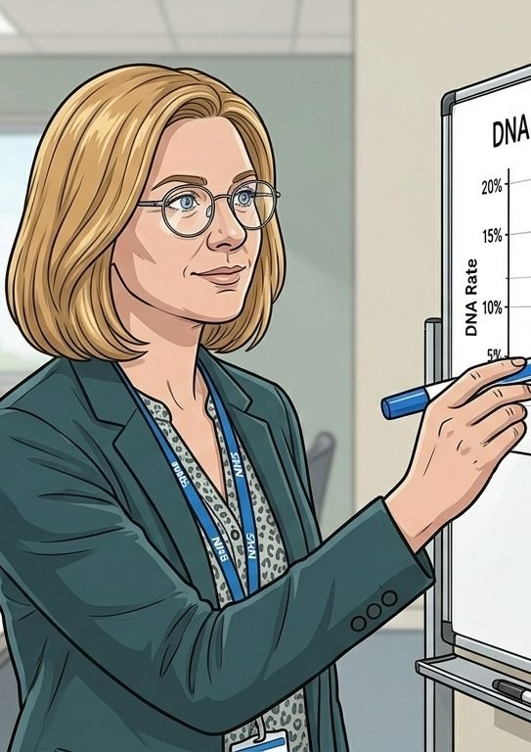
CLINICIAN · A CLINICIAN'S STORY THROUGH THE OPERATING MODEL
Hannah
GP partner · Primary-care monitoring
The bloods that never needed a clinic.
Hannah is a GP partner. She runs the routine Iron deficiency anaemia review cycle for her practice. Layla is on her list. So are a hundred others. Every quarter she runs the same six-month FBC clinic, and every quarter the same patients miss the appointment, get rebooked, and miss again. The cycle has nothing to do with the bloods themselves. This is the story of how the model lets her hold the cohort without holding their diaries.
1
2
3
4
5
6
The list · the patients she keeps rebooking
The missed appointment · the structural problem
The model's offer · kit out
First home prescriptions · Layla and the early cohort
Routine monitoring in flight · FBCs in the record
The practice shape now · slots for the patients who need clinic
The clinical accountability does not move. The venue does. Hannah is not interested in a model that bypasses her record or sends raw numbers to a patient. The FBC result lands in her GP system as if it had been drawn at the practice. The kit changes where the blood is taken. It does not change who reads the trend or who decides what happens next.
Hearts and Minds · the whole cast, one deck · HomeTest operating model · September 2026
Commercial positions are agreed in principle and remain subject to the live procurement.
12
Notes:
Hannah: The bloods that never needed a clinic. Hannah is a GP partner. She runs the routine Iron deficiency anaemia review cycle for her practice. Layla is on her list. So are a hundred others. Every quarter she runs the same six-month FBC clinic, and every quarter the same patients miss the appointment, get rebooked, and miss again. The cycle has nothing to do with the bloods themselves. This is the story of how the model lets her hold the cohort without holding their diaries.

Slide 13

SUPPLIER · A SUPPLIER'S STORY THROUGH THE OPERATING MODEL
Joe
Self-sample supplier · Framework-admitted
Admitted once. Reused everywhere.
Joe runs a self-sample diagnostics business. Twenty staff, two labs, a kit, a clinical safety officer, the regulatory paperwork done. The market is fragmented, every commissioner wants their own DPIA, their own contract, their own assurance pack. This is the story of how the framework turns one admission into many deployments, without a fresh assurance pass each time.
1
2
3
4
5
6
Find the framework · the public criteria pack
Self-assess · no NHSE meeting needed yet
Submit the EOI · structured
Through the gate · triage
First commissioner calls off · no re-assurance
Reuse across the cohort · one certificate
Assure once. Reuse nationally. A supplier evidences core compliance once per API they connect to. Adding a new test under an onboarded API is a lightweight check, not a full repeat. The clinical safety case, the IG package and the lab assurance are then portable across every commissioner who calls them off. The local body acts as the deployment authority. Not as a re-assurer.
Hearts and Minds · the whole cast, one deck · HomeTest operating model · September 2026
Commercial positions are agreed in principle and remain subject to the live procurement.
13
Notes:
Joe: Admitted once. Reused everywhere. Joe runs a self-sample diagnostics business. Twenty staff, two labs, a kit, a clinical safety officer, the regulatory paperwork done. The market is fragmented, every commissioner wants their own DPIA, their own contract, their own assurance pack. This is the story of how the framework turns one admission into many deployments, without a fresh assurance pass each time.

Slide 14
HEARTS AND MINDS
Abdul
Devi
Layla
Mark
Sean
Anita
Catherine
Ruth
Sarah
Adam
Hannah
Joe
Built around people. Bought without pain. Live today.
Hearts and Minds · the whole cast, one deck · HomeTest operating model · September 2026
Commercial positions are agreed in principle and remain subject to the live procurement.
14

